Slide 1
Employee Data Analysis using Excel
STUDENT NAME: GAYATHRI M
REGISTER NO: 2213371036210
(672A94943B7350C99E44E155DFE57864)
DEPARTMENT: COMMERCE
COLLEGE: Quaid-E-Millath Government College for Women (Autonomous)

Slide 2
PROJECT TITLE
Employee Performance Analysis using Excel

Slide 3


AGENDA
Problem Statement
Project Overview
End Users
Our Solution and Proposition
Dataset Description
Modelling Approach
Results and Discussion
Conclusion
3/21/2024 Annual Review

Slide 4

PROBLEM STATEMENT
To analyze the performance of employees over a specified period and identify key metrics that indicate performance trends. The analysis will help in understanding employee productivity, areas for improvement, and overall contribution to the organization's goals.

Slide 5

PROJECT OVERVIEW
.
Employee performance analysis is nothing but analysis the performance of the employee by considering various factors like Gender , Code , Ratings , Achievement's . In order to identify the trends and patterns of different categories of employee by their scores.

Slide 6
WHO ARE THE END OF USERS Employees: In some cases, employees themselves are the end users, using the data to understand their performance, identify areas for improvement, and set personal goals. Performance Analysts: These professionals may be involved in the detailed analysis and presentation of performance data, providing insights and reports to other stakeholders.

Slide 7

OUR SOLUTION AND ITS VALUE PROPOSITION
Filtering- Missing Values
Conditional formatting - blank values pivot Table
Grahp-For data visualization

Slide 8
Dataset Description
Employee = kaggle
26 features
9 features employee -ID- numerical values.
Name-Text- Employee Types of performance level Gender - Male,Female
Employee rating - Numerical values

Slide 9

THE "WOW" IN OUR SOLUTION
. Interactive and Dynamic Dashboards
. Advanced Visualization
Predictive Analytics and Forecasting
Automated Reporting
Integration with External Data Sources
3/21/2024 Annual Review
9

Slide 10
MODELLING
DATA COLLECTION :
Double tap to add text
Downloaded the employee Data performance From edunet Dashbard
DATA CLEANING
Identified The Missing Values
Filtered the missing values
VISUALIZATION
Graph
10

Slide 11
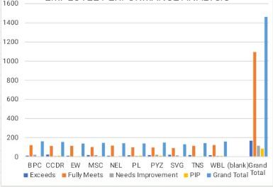
RESULTS
EMPLOYEE PERFORMANCE ANALYSIS
11

Slide 12
conclusion
Employee performance is analysis is a critical process that goes beyond simply evaluating past achivements. It plays a vital role in understanding the strengths And areas for improvement within your workforce,guiding informed decisions that enhances productivity and drive organizational sucess.

